Slide 1
Information from sessions

Slide 2
Your hot cross bun
Situation- Social situation
T-Worries re what others think
F-Feel paranoid, did he like me
B-Post and pre processing
Withdraw from people
Argument with partner
Perceive comments as insults particularly around things linked to my body
I am not being listened to
I am right there is no other perspective of this situation
I prioritize my needs and not my partners
Sometimes rise my voice and recognize it
Stop speaking and put hand over mouth if raise voice or go back to normal volume
Punch leg or stomach in past as release to get anger out
Down and sorry for myself
Angry
Selfish
Righteous
Tension in my whole body
Sinking want ground to swallow me up
Random negative thoughts cause physical almost Cringe(?) reactions in my body, making weird noises, etc.

Slide 3
Your hot cross bun
Situation/ triggering event
Thoughts
Feelings
Behaviour/ how I respond to the trigger
Physical sensations

Slide 4

Thinking traps

Slide 5
Setting your SMART Goals
Specific
Measurable
Attainable
Realistic
Time

Slide 6
Setting your SMART Goals
0 Not Met AND 10 Met
I want to shut down less, be able to stop myself withdrawing (twice every fortnight). I want to feel that I can overcome it rather than be drowned by it. I want to feel less angry at myself and less inclined to hurt myself because of it. I try to confront the conflict but often make it worse because I don’t tend to handle it very well. 4 (3.3. 25)
Would like help to understand what needs to ask and approach a situation when I feel angry because of this with his partner

Slide 7
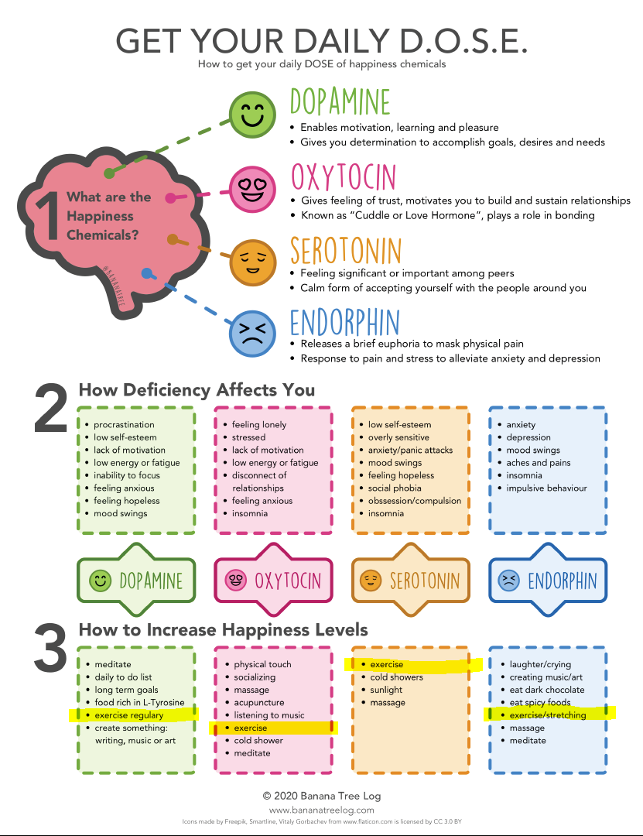
Get your daily D.O.S.E.
Dopamine | Oxytocin | Serotonin | Endorphin

Slide 8

Resource bowl
8
What sustains me?
Activities/ realistic goals
What sustains me?
Reasonable demands/ supportive relationships
Talking with my partner
Sharing interests
Sleep
Nice food
Time to myself (doesn’t have to be long)
Exercising
Baking/cooking
Editing videos
Learning about interests
(neuroscience, 3d modelling, video editing)
What drains me? Unhelpful activities/ unrealistic goals
Cleaning
Working at Sainsbury’s
Arguments
Social obligations/Socialising
Washing dishes
What drains me? Unreasonable demands/ unsupportive relationships
Not feeling heard
Feeling invisible
Feeling unappreciated or unloved (or anything that makes me feel that way)
What drains me?
Daily demands of life

Slide 9
Stress Bucket
Stress Bucket - YouTube

Slide 10
Automatic thoughts
What are automatic thoughts
Everyone has them
We have around 60,000-100,000 a day. Help us interpret world around us describing what happening, make sense of things and help interpret things, sights, events, smells feelings.
Can be helpful to identifying type of automatic thought if helpful or unhelpful and the meaning belief we give to that thought

Slide 11
Videos for thoughts
https://www.youtube.com/watch?v=VYht-guymF4
Example of neighbour Brian coming in and being annoying and stopping him enjoying party-example of intrusive thoughts
https://www.youtube.com/watch?v=tzUoXJVI0wo
The Sushi train metaphor-Brain is chef sushi is thoughts and watch them go by (accepting thoughts as waves coming over us and going) Cant stop thoughts but can step back and be curious and watch them go by.
https://www.youtube.com/watch?v=Z29ptSuoWRc
Bus driver Tom pushing thoughts/feelings away

Slide 12
Negative automatic thoughts-NAT’s
NAT are typically the primary experiences that lead to mood and behavioural symptoms.
These NAT comes from the automatic thoughts we have each day and more depressed we feel more likely have NAT which impact our mood/feelings
Automatic- come into mind without any effort
Twisted- Present themselves as fact but if examine closet usually find little or no evidence
Believable to you that is-NATS are smart but sneaky. Make sure you accept them without question. They can brainwash you in to believing true
Unhelpful-Get you feeling down and keep you there

Slide 13
What are you most common NATs?

Slide 14

Unhelpful thoughts
Like ink in clear water, when we have a bad thought it spreads and the color changes.
We need to be able to control the ink to keep the water clear

Slide 15
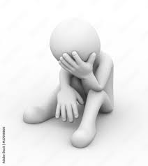
Unhelpful thinking
I am useless
I am worthless
Everyone always lets me down
When people think negatively about themselves, the world around them and their future, they see the world through gloomy specs.
When we repeatedly dwell on these thoughts, we can feel regretful about things in the past, and what we should or shouldn’t have done.
What’s the point? Everything goes wrong.
It’s hopeless, nothing will ever change

Slide 16


Thoughts, rules and core beliefs
Flowers (Automatic thoughts)
Roots
(Core beliefs)
Weeds
(Negative Automatic thoughts)
Soil (Rules for living)

Slide 17
Your hot cross bun
Situation/ triggering event
Thoughts
Feelings
Behaviour/ how I respond to the trigger
Physical sensations

Slide 18
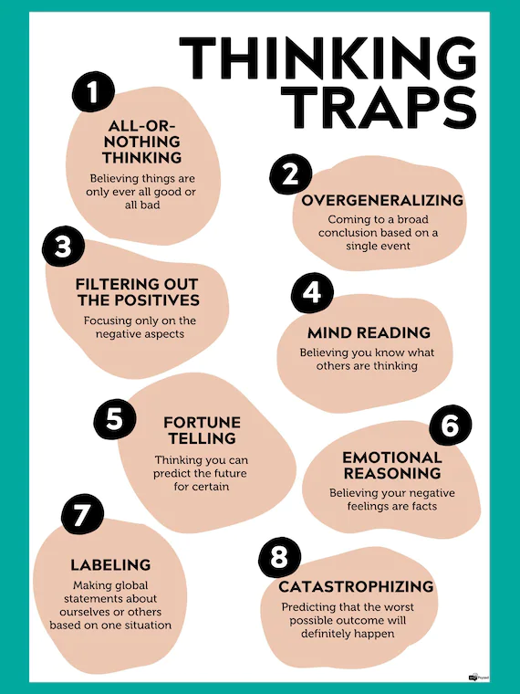
Thinking traps
Our minds are constantly appraising the world around us.
There is always some difference between what’s going on in the world around us and how we perceive that world.
The mind inevitably constructs its appraisals with limited information. We develop shortcuts to make sense of things.
These imperfect appraisals get woven into a greater narrative about ourselves, other people, and the world.
Example: we see a friend in the street, we wave and shout hello. They ignore us. What do we think is happening?

Slide 19
Home task
Complete goal 2 make it SMART
Write down your negative thoughts
Try to use the resource bowl improve self awareness
Look at handout on thing errors

